Slide 1
Custom Library
Brandon Moe

Slide 2
Todays Topics
The Teams Custom VI
How they can be beneficial

Slide 3
Custom VI and what they mean to you

Slide 4
Custom VI
A custom VI is one that we have modified to fit our needs
They save us time and accomplish task specific to our team.
These get built upon every year
All of these will be available under the folder 3026 VI

Slide 5
VI’s explained

Slide 6
Robot Drive

Slide 7

Drive Mode
Used to tell the robot what drive mode it is in
Requirements
none
Returns
Drive Mode Selected

Slide 8
MecaTrak
Used in 2016
For the drive train with tank tracks and mecanum wheels

Slide 9

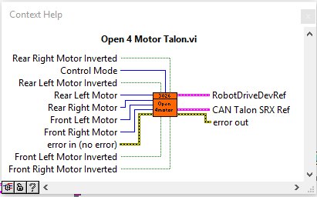
Open 4 Motors
Used to open a 4 motor Talon SRX CAN drive
Requirements
4 CAN numbers
4 motors inverted Boolean
Control Type
Returns
Initialized Drive

Slide 10

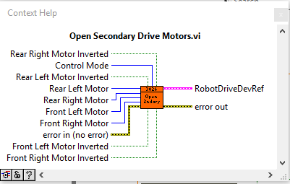
Secondary Drive
Used if we have a 6 CIM drive (Which we usually do)
Give the front 2 motor bogus CAN numbers
Requirements
2 CAN numbers
2 motors inverted Boolean
Control Type
Returns
Initialized Drive

Slide 11

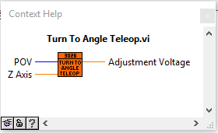
Turn to angle
Takes in an angle and will turn the robot to that angle
Requirements
Angle desired (null is -1)
Z axis
Returns
Proper rotation value

Slide 12

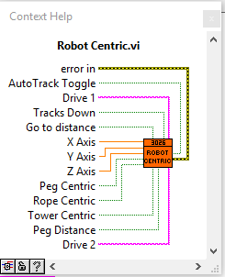
Robot Centric
Custom Robot Centric Drive

Slide 13
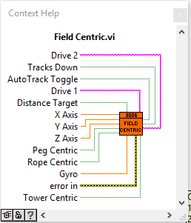
Field Centric
Our Custom Field Centric Drive

Slide 14
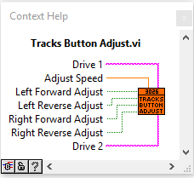
Track Button Adjust
Adjust the robot by only turning one motor
Requirements
Adjust speed
Buttons for adjustment
Drive reference num
Returns
Motors adjusting independently

Slide 15
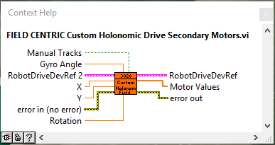
“Homie Drive
Used in robot to not flip field orientation from robot centric

Slide 16

Strafe Correction
On mecanum robots if it is not strafing properly this vi will fix it

Slide 17
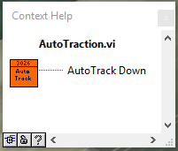
Auto Tracks Down
This will put the tracks down automatically
Requirements
4 motor values
Returns
Boolean if tracks should be down

Slide 18
NavX

Slide 19

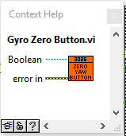
Zero Yaw
This is hooked up to the button on the joystick that will zero the yaw on the NavX
Requirements
Button
Returns
None

Slide 20
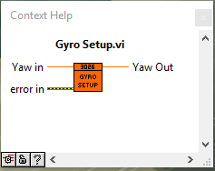
Gyro Setup
This will set up the yaw angle so we can use it correctly
Requirements
Yaw
Returns
Corrected Yaw

Slide 21

NavX Variable Get
This will get all of the variables from the NavX
About 15 variables total

Slide 22
Vision

Slide 23
WARNING
Do not touch these only use them!
These are very complex VI that you need years of experience to modify
And trust me these will just give you headaches. Just use them and be grateful.

Slide 24
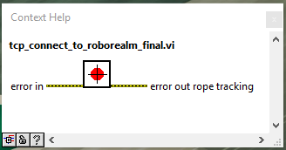
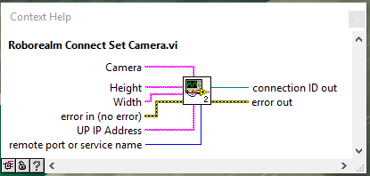
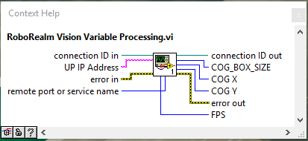
RoboRealm
Sets Up Camera
Gives you everything you need to vision track

Slide 25
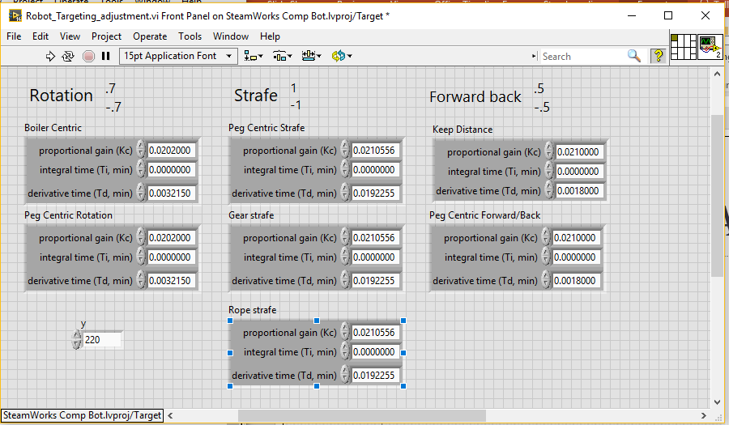
Robot Targeting Adjustment
This one you can touch
This is used to adjust the robot for vision targets
When looking at this please parden the mess

Slide 26
Extras

Slide 27

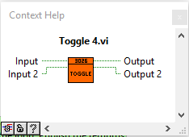
Toggle
Used for toggling buttons
LabVIEW did not have one of these VI so we made one
Requirements
Button input (up to 2)
Returns
Inputs on toggle

Slide 28
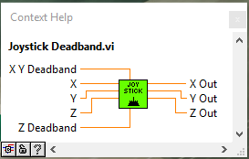
Joystick Deadband
Used to put a dead band on the joysticks
Requirements
X, Y, and Z axis
XY dead band and Z dead band
Returns
Joystick values with deadband

Slide 29
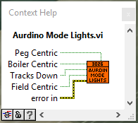
Arduino Light Mode
Used for communicating with Arduino
Requirements
The 4 Boolean values
Returns
Arduino with correct lights

Slide 30
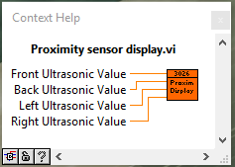
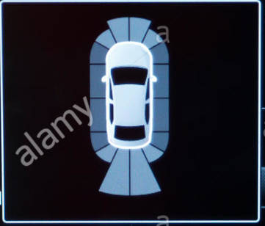
Proximity Display
It is essentially this
Requirements
4 ultrasonic sensors

Slide 31
Lab 3
Place the toggle VI in teleop x2
Place the Joystick deadband in teleop x2
Place the Zero Yaw in teleop
Place the Arduino Light Mode in teleop

